Slide 1
Accident Severity Prediction

Slide 2
Severity Prediction is vital for many governments
Millions of human lives are lost each years
Prediction of the severity and understanding the key factor that contribute to these car accidents becomes vital for many governments across the world
Enables in creation of
optimized traffic systems
safer routes
better transport infrastructure.

Slide 3
Data Acquisition and Cleaning
The crash data used for the project is of the dataset provided in Kaggle
Comprises of information regarding the collisions from the year 2016 and collected from multiple data sources
Cleaned 5 features

Slide 4

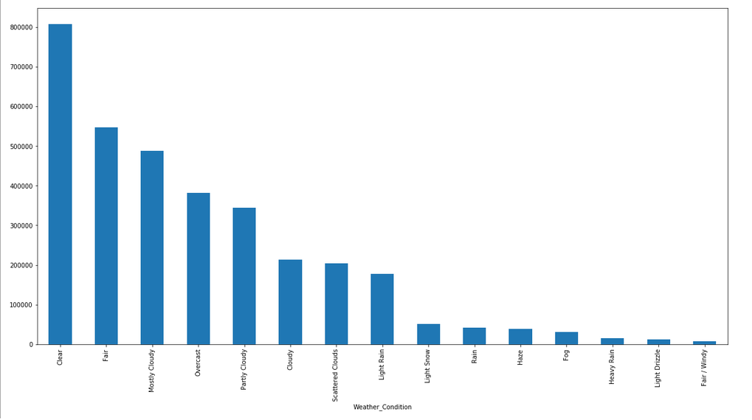
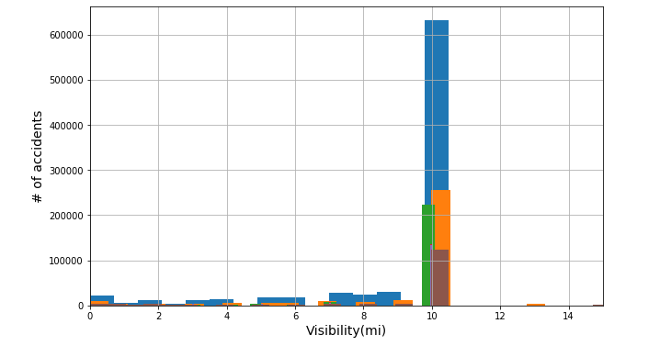
Impact of weather on accident
Visibility not affecting accidents

Slide 5
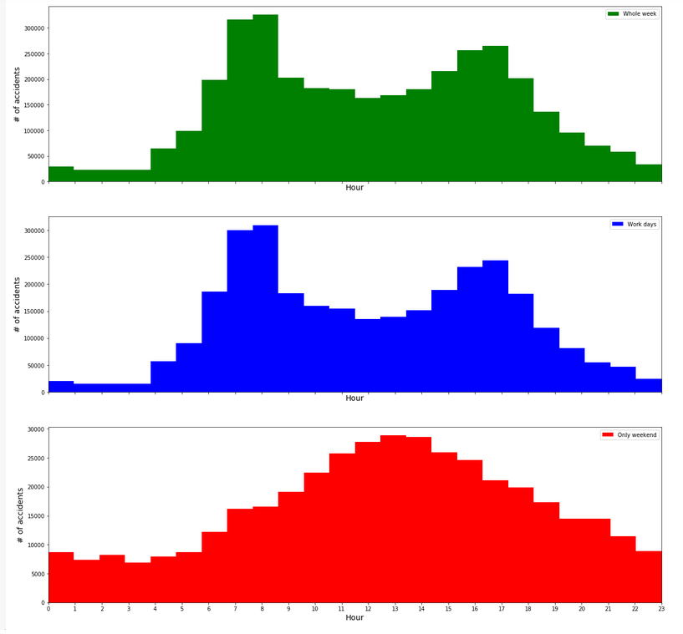
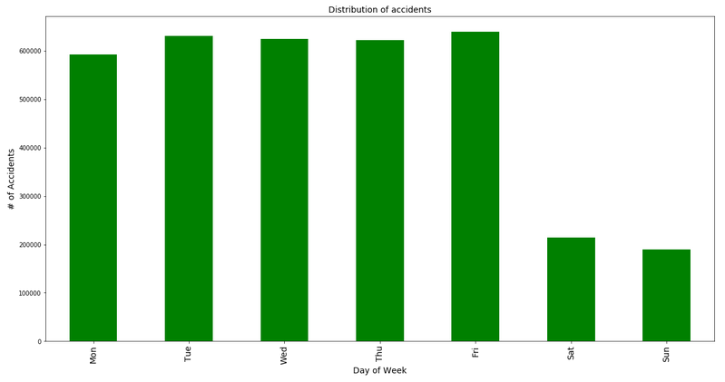
Weekdays shows higher accidents during office hours, weekend shows during noon time
Weekdays shows higher accidents

Slide 6
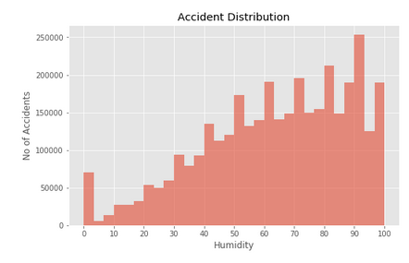
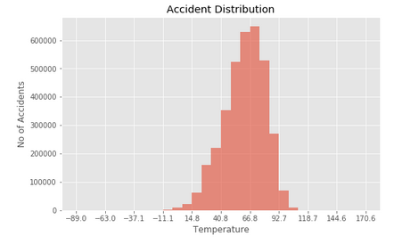
Humidity and Temperature shows impact on the accidents

Slide 7
Classification Model: Performance
 | Logistic Regression | Decision Tree
Log Loss | 0.7603603252166787
Accuracy | 0.675574294075 | 0.67575985778

Slide 8
Conclusion and Future Direction
Built useful models to predict accident severity
Accuracy of the models has room for improvement.
Capture more of accident information, individual information, vehicular information

